Slide 1
Pandas Series

Slide 2
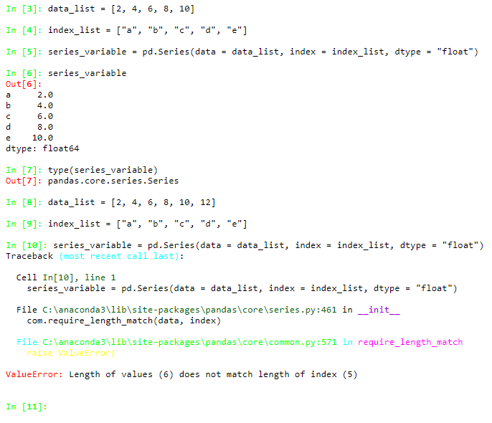
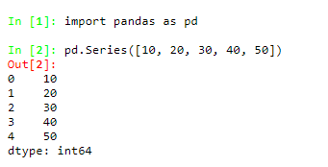
Creating a Pandas Series with Lists
Building block of DataFrame
Pandas Series – created based on Numpy Arrays
Keeps index information for each value as an extra
Index | Value
0 | 10
1 | 20
2 | 30
3 | 40
4 | 50

Slide 3
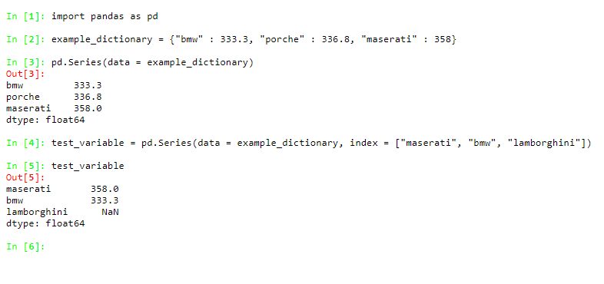
Creating a Pandas Series with Dictionaries

Slide 4
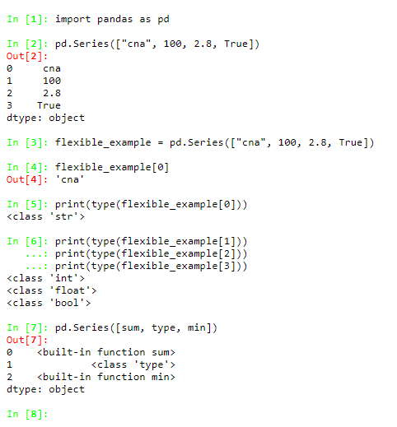
Object types in Pandas Series

Slide 5
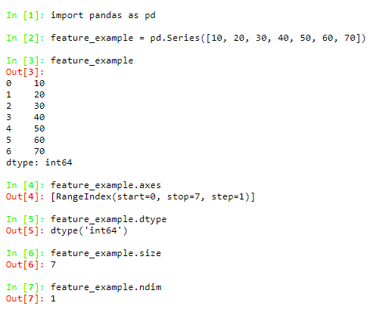
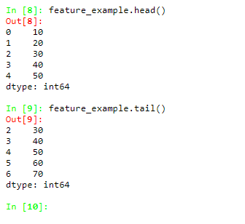
Primary Features of the Pandas Series

Slide 6
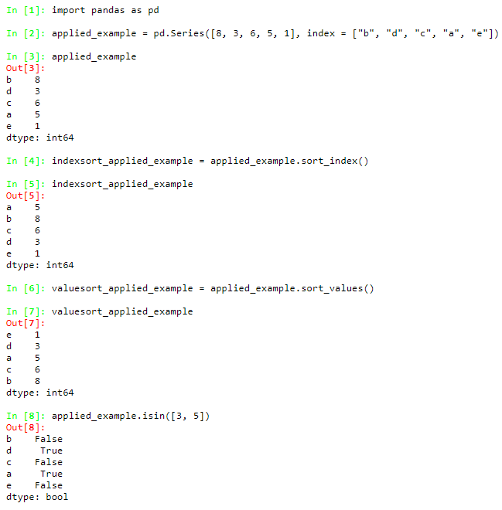
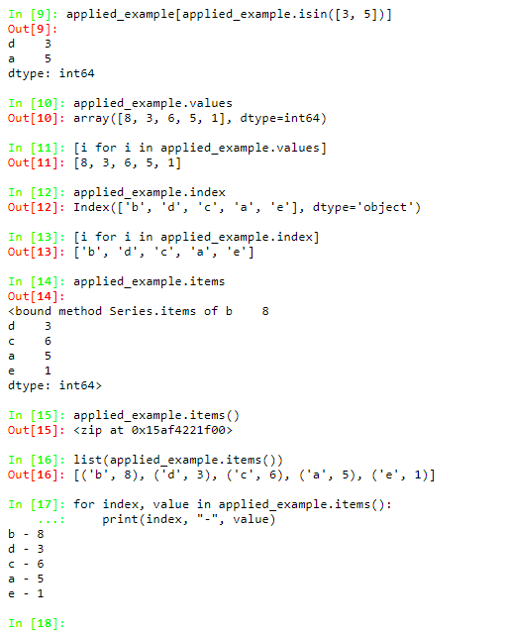
Most Applied Methods of the Pandas Series

Slide 7
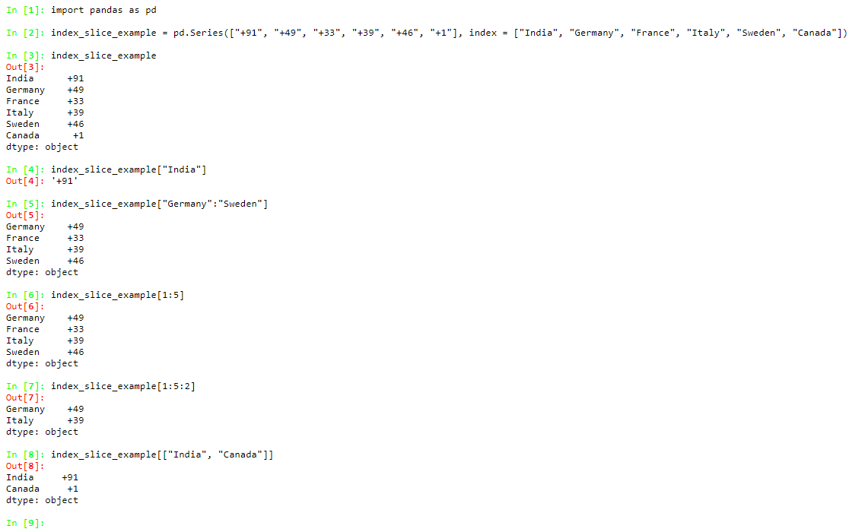
INDEXING and SLICING Pandas Series

